Slide 1
Contents Delivery Networks
(Over 1 billion served … each day)

Slide 2
Outline
Motivation
CDN basics
Prominent example: Akamai

Slide 3
Content in today’s Internet
Most flows are HTTP
  Web is at least 52% of traffic
  Median object size is 2.7K, average is 85K (as of 2007)

Slide 4
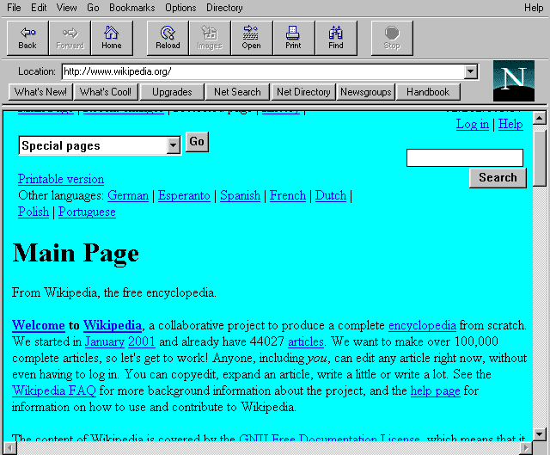
Evolution of Serving Web Content
In the beginning…
  …there was a single server
  Probably located in a closet
  And it probably served blinking text
Issues with this model
  Site reliability
    Unplugging cable, hardware failure, natural disaster
  Scalability
    Flash crowds (aka Slashdotting)

Slide 5
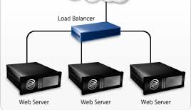
Replicated Web service
Use multiple servers
Advantages
  Better scalability
  Better reliability
Disadvantages
  How do you decide which server to use?
  How to do synchronize state among servers?

Slide 6
Load Balancers
Device that multiplexes requests
across a collection of servers
  All servers share one public IP
  Balancer transparently directs requests
  to different servers
How should the balancer assign clients to servers?
  Random / round-robin
    When is this a good idea?
  Load-based
Challenges
  Scalability (must support traffic for n hosts)
  State (must keep track of previous decisions)
    RESTful APIs reduce this limitation

Slide 7
Load balancing: Are we done?
Advantages
  Allows scaling of hardware independent of IPs
  Relatively easy to maintain
Disadvantages
  Expensive
  Still a single point of failure
  Location!
Where do we place the load balancer for Wikipedia?

Slide 8
Popping up: HTTP performance
For Web pages
  RTT matters most
  Where should the server go?
For video
  Available bandwidth matters most
  Where should the server go?
Is there one location that is best for everyone?
Notes:
RTT - Round Trip Time

Slide 9

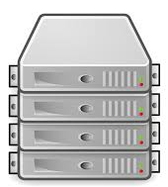
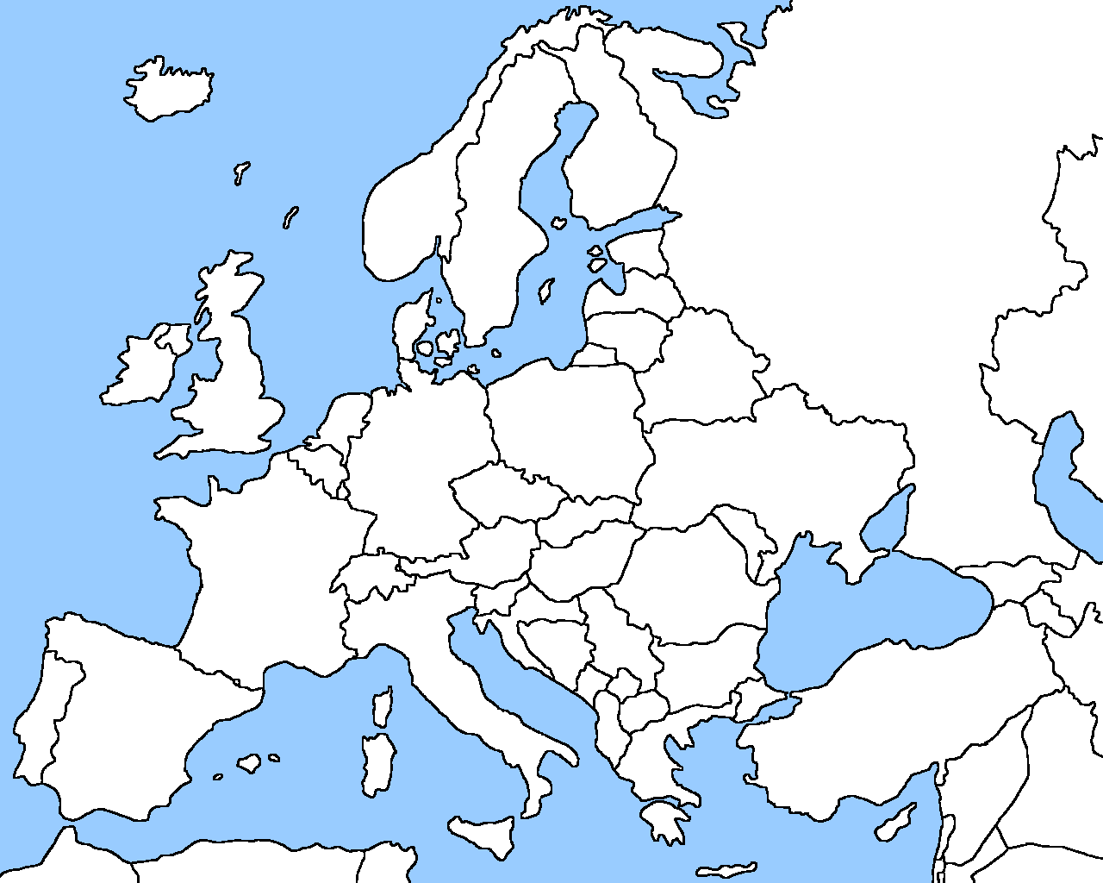
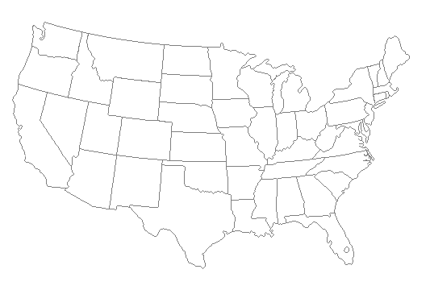
Server placement

Slide 10
Why speed matters?
Impact on user experience
  Users navigating away from pages
  Video startup delay

Slide 11

Why speed matters?
Impact on user experience
  Users navigating away from pages
  Video startup delay
Impact on revenue
  Amazon: increased revenue 1% for every 100ms reduction in PLT
  Shopzilla:12% increase in revenue by reducing PLT from 6 seconds to 1.2 seconds
Ping from BOS to LAX: ~100ms

Slide 12
Strawman solution: Web caches
ISP uses a middlebox that caches Web content
  Better performance – content is closer to users
  Lower cost – content traverses network boundary once
  Does this solve the problem?
No!
  Size of all Web content is too large
    Zipf distribution limits cache hit rate
  Web content is dynamic and customized
    Can’t cache banking content
    What does it mean to cache search results?

Slide 13
Outline
Motivation
CDN basics
Prominent example: Akamai

Slide 14
What is a CDN?
Content Delivery Network
  Also sometimes called Content Distribution Network
  At least half of the world’s bits are delivered by a CDN
    Probably closer to 80/90%
Primary Goals
  Create replicas of content throughout the Internet
  Ensure that replicas are always available
  Directly clients to replicas that will give good performance
https://docs.microsoft.com/en-us/azure/cdn/

Slide 15
Key Components of a CDN
Distributed servers
  Usually located inside of other ISPs
  Often located in IXPs (coming up next)
High-speed network connecting them
Clients (eyeballs)
  Can be located anywhere in the world
  They want fast Web performance
Glue
  Something that binds clients to “nearby” replica servers
Notes:
IXP = Internet exchange point. is a physical location through which Internet infrastructure companies such as Internet Service Providers (ISPs) and CDNs connect with each other.

Slide 16

Key CDN Components
16

Slide 17
Examples of CDNs
Akamai
  147K+ servers, 1200+ networks, 650+ cities, 92 countries
Limelight
  Well provisioned delivery centers, interconnected via a private fiber-optic connected to 700+ access networks
Edgecast
  30+ PoPs, 5 continents, 2000+ direct connections
Others
  Google, Facebook, AWS, AT&T, Level3, Brokers

Slide 18
Inside a CDN
Servers are deployed in clusters for reliability
  Some may be offline
    Could be due to failure
    Also could be “suspended” (e.g., to save power or for upgrade)
Could be multiple clusters per location (e.g., in multiple racks)
Server locations
  Well-connected points of presence (PoPs)
  Inside of ISPs

Slide 19
Mapping clients to servers
CDNs need a way to send clients to the “best” server
  The best server can change over time
  And this depends on client location, network conditions, server load, …
DNS-based redirection
  Clients request www.foo.com
  DNS server directs client to one or more IPs based on request IP

Slide 20
CDN redirection example
choffnes$ dig www.fox.com
;; ANSWER SECTION:
www.fox.com. 510 IN CNAME www.fox-rma.com.edgesuite.net.
www.fox-rma.com.edgesuite.net. 5139 IN CNAME a2047.w7.akamai.net.
a2047.w7.akamai.net. 4 IN A 23.62.96.128
a2047.w7.akamai.net. 4 IN A 23.62.96.144
a2047.w7.akamai.net. 4 IN A 23.62.96.193
a2047.w7.akamai.net. 4 IN A 23.62.96.162
a2047.w7.akamai.net. 4 IN A 23.62.96.185
a2047.w7.akamai.net. 4 IN A 23.62.96.154
a2047.w7.akamai.net. 4 IN A 23.62.96.169
a2047.w7.akamai.net. 4 IN A 23.62.96.152
a2047.w7.akamai.net. 4 IN A 23.62.96.186

Slide 21
Optimizing Performance
Key goal
Send clients to server with best end-to-end performance
Performance depends on
  Server load
  Content at that server
  Network conditions
Optimizing for server load
  Load balancing, monitoring at servers
  Generally solved

Slide 22
Outline
Motivation
CDN basics
Prominent example: Akamai

Slide 23
Akamai case study
Deployment
  147K+ servers, 1200+ networks, 650+ cities, 92 countries
  highly hierarchical, caching depends on popularity
  4 yr depreciation of servers
  Many servers inside ISPs, who are thrilled to have them
  Deployed inside100 new networks in last few years
Customers
  250K+ domains: all top 60 eCommerce sites, all top 30 M&E companies, 9 of 10 top banks, 13 of top 15 auto manufacturers
Overall stats
  5+ terabits/second, 30+ million hits/second, 2+ trillion deliveries/day, 100+ PB/day, 10+ million concurrent streams
  15-30% of Web traffic

Slide 24
Somewhat old network map

Slide 25
Akamizing Links
Embedded URLs are Converted to ARLs
<html>
<head>
<title>Welcome to xyz.com!</title>
</head>
<body>
<img src=“http://www.xyz.com/logos/logo.gif”>
<img src=“http://www.xyz.com/jpgs/navbar1.jpg”>
<h1>Welcome to our Web site!</h1>
<a href=“page2.html”>Click here to enter</a> </body>
</html>
AK

